Slide 1
Character Recognition System
Presented By
Zubayet Zaman Zico(144406)
Shadman Protik(144428)
Prottoy Hashem(144427)

Slide 2
Introduction
Character recognition is the ability or a system which receives the input from the touch screen, images, paper documents, electronic pen, scanner etc.
Character recognition is used to recognize the words, alphabets, digits
Useful in the sector of documentation analysis, mailing address interpretation, bank check processing, signature verification, postal addresses etc.
Offline and online character recognition is normally conventional.

Slide 3
Ways of Implementation
Several algorithms are being used to implement the handwriting recognition system like-
Back propagation algorithm
Fuzzy theory
Neural network based recognition system
Recognition system based on KNN classifier

Slide 4
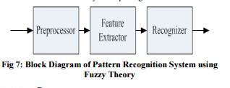
Hand-Printed English Character Recognition based on Fuzzy Theory

Slide 5
STEPS
Pre processing:
In this step the document scanning are performed. There are number of tools are present to perform this step.
Feature Extraction:
The recognition rate mainly depends on the feature of the character. Feature can be structural, topological and geometrical. Geometrical features like angle and distance are explored in order to achieve high recognition rate. The properties that need to determine in fuzzy theory are number of circles, number of strokes and numbers of dots.

Slide 6
STEPS
Character recognition:
After feature extraction a recognition system is used to identify the corresponding character. Here we used fuzzy theory to recognize the character. In this method a variation is deal with the membership function which is composed by x, y coordinates and length of the segment of the character. And then degree to compare segments of input to segment in database is calculated
Notes:
There four steps are present for handwritten English character.
In first step is read an input data from the handwritten documents. These characters are saved in binary bitmap format. The input image resolution should be 100x100 pixels to make sure that the character is not too big and small.
In second step extraction of features are present. There are six segments are present, which consist dot(D), circle(C), rightincline line (RI), left-incline line (LI), up-down line(UD), leftright line (LR) as feature parameters.
In third step matching the target image with the training images is performed and calculates the degree of similarity is calculated using Min-Max operation. For calculating the degree of similarity we have to fuzzify each input segment.
In the last step system represent the result in a printed character.

Slide 7
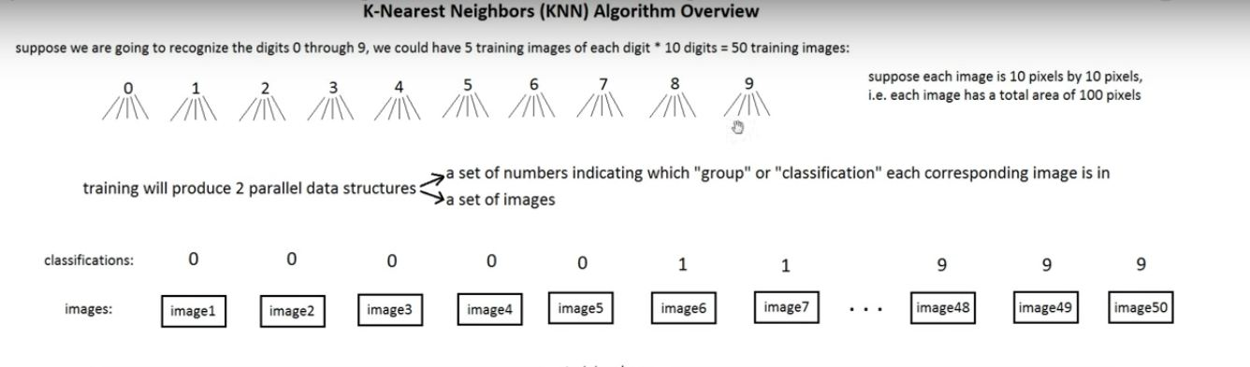
KNN classifier

Slide 8
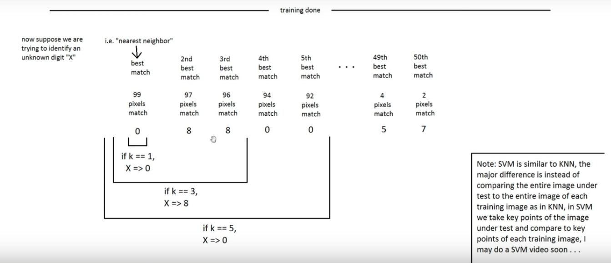
KNN classifier

Slide 9
Generating Data Process:
First we load the image. If there is no image it returns an error.
Then we convert the image to gray scale then we add blur. Then we convert the image to black and white image.
We convert the 2d array into 1d numpy array.
Then we find the characters from the image. If the contour area is too small, then we skip it.
Then first we get all the flatten images.
Then we classify the characters

Slide 10
Testing Data Process
We again get the images and characters like we did in Generating Data.
We then run a knn classifier to successfully identify the characters.
If it has a # character in it , then we treat it as a mathematical equation and solve it and print the answer
If it doesn’t have the # key then it treat the data as simple text. And print the text.

Slide 11
References
http://neuralnetworksanddeeplearning.com/chap1.html
http://machinelearningmastery.com/handwritten-digit-recognition-using-convolutional-neural-networks-python-keras/
http://research.ijcaonline.org/volume114/number19/pxc3902131.pdf

Slide 12
THANK YOU

